Slide 1



SUBSCRIBER OPTIMIZATION FOR
ROSETTA
STONE
THE DATA MINERS
Charlotte Belke, Joseph Calise, Josh Drake, Ronan Kearns, Ryan King, Nella Khachian,
Notes:
Hello everyone, we are the data miners and here’s our Subscriber Optimization for Rosetta Stone!

Slide 2
Agenda
Introduction
Action Plan
Cleaning
Q1. Valuable Subscriber Identification
Q2. Subscriber Segment Analysis
Q3. Upsell Subscriber Identification
Q4. Non-Renewal Subscriber Profile
Q5. Business Opportunity Insights
Conclusion
Notes:
This is our Agenda of what we’ll discuss today!

Slide 3
INTRODUCTION
Notes:
Lets get started!
Project Context: Rosetta Stone Analytical Team Presentation.
Objective: Analyzing app activity and subscriber datasets for insights.
Analysis Goals: Identifying premier subscribers for potential upselling. Recognizing subscribers poised for additional product/service sales. Detecting subscribers disengaging from the product.
Strategic Approach: Comprehensive analysis: data cleaning, transformation, and exploration. Utilizing data visualizations for clear, impactful presentation of findings.
Business Focus: Exploring strategic opportunities for Rosetta Stone's future growth.

Slide 4
Action Plan
 | Week 1 |  |  |  |  |  |  | Week 2
 | 1 | 2 | 3 | 4 | 5 | 6 | 7 | 8 | 9 | 10 | 11 | 12 | 13 | 14
Open Data:
Data Discovery: |  |  |  |  |  | ◆
Data Cleaning / Transformation:
Early Visualization:
Modeling: |  |  |  |  |  |  |  |  |  | ◆
Consolidation and Analysis: |  |  |  |  |  |  |  |  |  |  |  |  | ◆
Documentation:
Presentation Creation:
Presentation Practice:
Notes:
Here’s a quick overview of our action plan; (dont think we should waste time on this)
Gantt Chart Action Plan– Can be added to appendix if not needed or need the slide space

Slide 5
Data Cleaning
Notes:
Let’s dive into our data cleaning!

Slide 6
Cleaning: Subscriber Dataset
Addressed NULL values in key columns: Purchase Amounts, Currency, Free Trial Dates, Notifications
Implemented currency conversion to USD from 2020 exchange data
Dropped Major Purchase Amount outliers ( > $100,000 USD)
Filled 1400 rows of that reflected $0 Web purchases with averages calculated by other Web purchases by the language and type observed.
Final row total: 38,611 observations.
After cleaning the team created two more datasets:
appFilled.csv: addresses unreliable app purchase amounts in original dataset
merged.csv: developed to combine subscriber data and app activity data
Notes:
Team created two other data sets for more specific models

Slide 7
Cleaning: App Activity Dataset
Tracks user actions within the app and includes platform used, action taken, and date.
Python for data assessment, cleansing and identified missing or null values
44,718 actions lacked platform data
Placed 'Unknown' for empty platform fields
14,420 entries missing both Activity Type and Date- removed to ensure data completeness
Original dataset: 809,478 data points
Post-cleaning: 795,058 rows
Aimed to retain maximum useful activity data

Slide 8
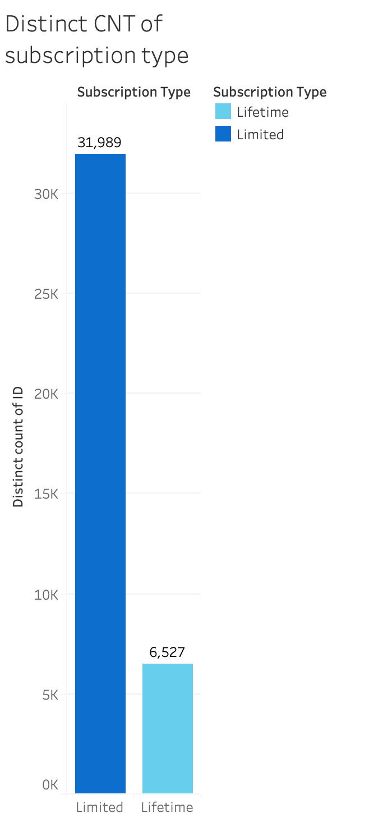
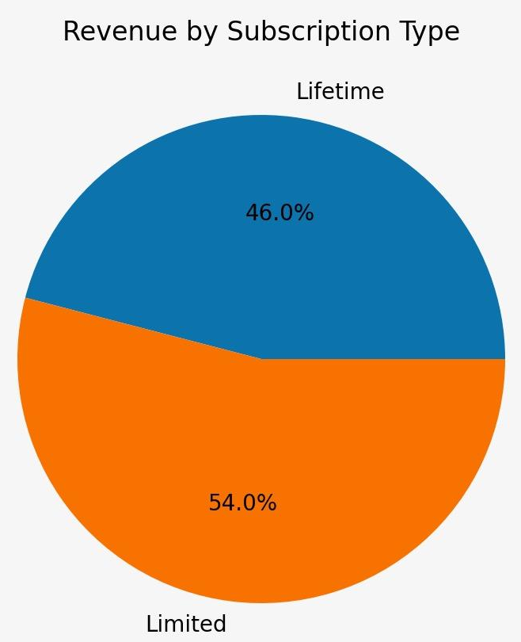
Understanding Subscriber Value
Q1
With a 66% difference, revenue is almost even!
We defined subscriber value by:
Revenue contribution
Subscription Type Breakdown:
83% Limited subscriptions
17% Lifetime subscriptions
Notes:
To define subscriber value, we focused on revenue contribution and developed linear regression models and data visualizations for deeper insights.
In our Analysis– which we sorted by most popular languages– we discovered, there are 66% more Limited than Lifetime subscriptions .
Keeping this in consideration, we found that even with this 2/3s (66%) difference, Lifetime subscriptions generate almost the same amount of revenue compared to all other subscription types…

Slide 9
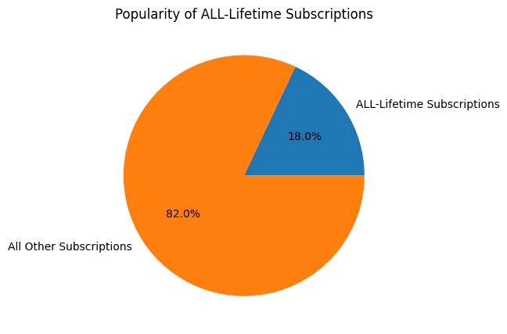
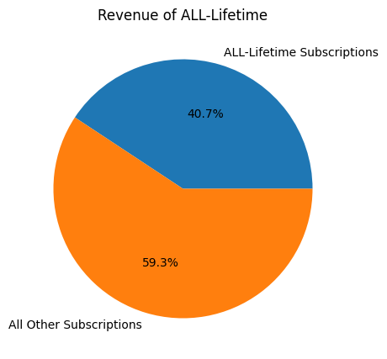
18%
of Subs make up
40.7%
of our Revenue
Q1
Most Valuable Subscribers: ALL-Language-Lifetime subscribers.
Assumption: ALL-Language-Lifetime subscribers have no further products to purchase, diminishing those customers’ remaining value.
Caveat: Growing Limited/Other subscriptions must take place to sustain revenue growth over time.
Notes:
Mention going deeper into the fact that lifetime subs make up a large portion of our revenue, we found that most of that is attributed to ALL-Language-Lifetime subscriptions.
In fact we found that ALL-Language-Lifetime Subscribers make up 18% of our subscriptions but those alone generate 40.7% of the Revenue!!! As you can see in the charts right here.
We therefore determine that the most valuable subscribers are ALL-Language-Lifetime subscribers and recommend increasing the number of ALL-Language-Lifetime customers which of course requires balancing customer acquisition costs against the revenue they generate
HOWEVER– Under the assumption that ALL-Language- Lifetime subscribers have reached the highest level of subscriptions considering Rosetta Stone’s business model– Converting existing customers to ALL-Language-Lifetime subscribers, means we can no longer sell them additional products, maxing out their purchasing potential. In order to determine the best conversion strategy, the company will need to evaluate the revenue created by increasing ALL-Lifetime Subscriptions and weigh it against new customer acquisition costs to replace the long term customer value we lose by upgrading existing customers to ALL-Languages-Lifetime.
So the Caveat is– to sustain revenue growth overtime, acquiring new limited subscriptions is also essential when when converting existing customers to ALL-Language-Lifetime subscribers, since once upgraded, they have reached their maximum purchasing potential.

Slide 10
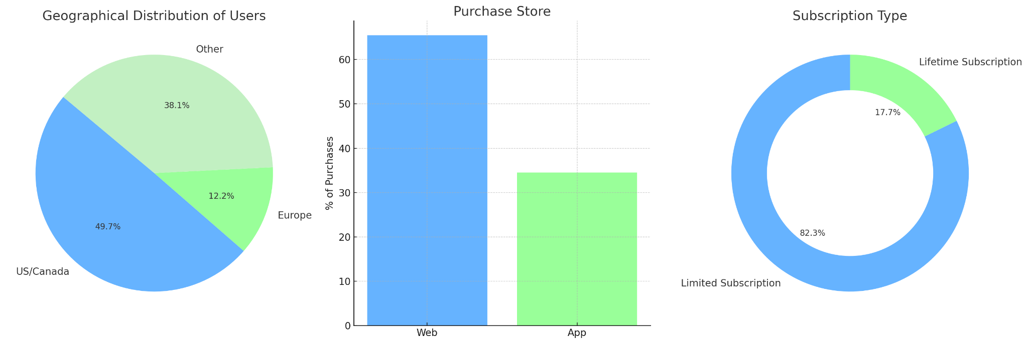
Typical Segmentations
Q2
Geographical Segment
Store Segment
Sub. Type Segment
Notes:
Here on the slide you can see a few of the basic customer segmentations we pulled from the data. We see that the majority of users are from the US and Canada, most activity comes from the website, and over 80% of customers are only on the limited subscription plan. However, this doesn’t tell us much of a story so we wanted to go deeper.

Slide 11
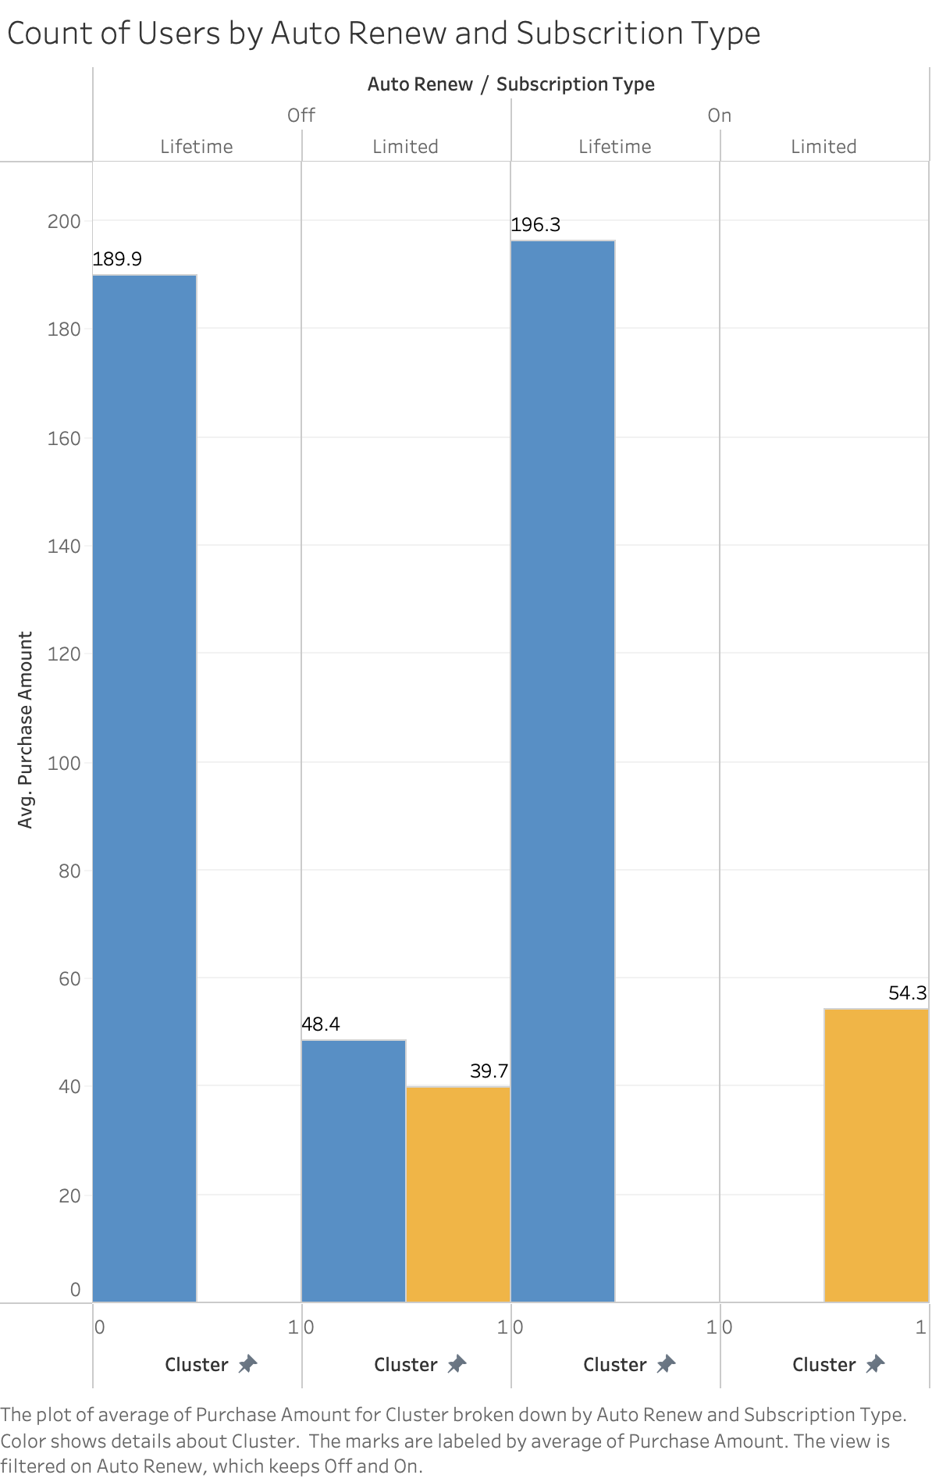
How do subscribers differ in behavior?
Q2
Behavioral Segment
Content Motivated:
Having auto renew on more often
On average pay 10% more than their counterparts
Have more interactions with the application
Have more completed units and modules in the application
Notes:
As we dug around, we found behavioral segments. Customers who are Content Motivated, and customers who are Price Motivated. We imagine these content motivated customers are determined learners who might have a personal or professional deadline and will pay more for the content to have it right away and subscribe to it longer. This segment will have a more defined learning plan and will keep themselves accountable and they on average complete more units and modules. Examples of this group could be travelers planning for a foreign trip, students supplementing their school studies, or business men and women for a job.

Slide 12
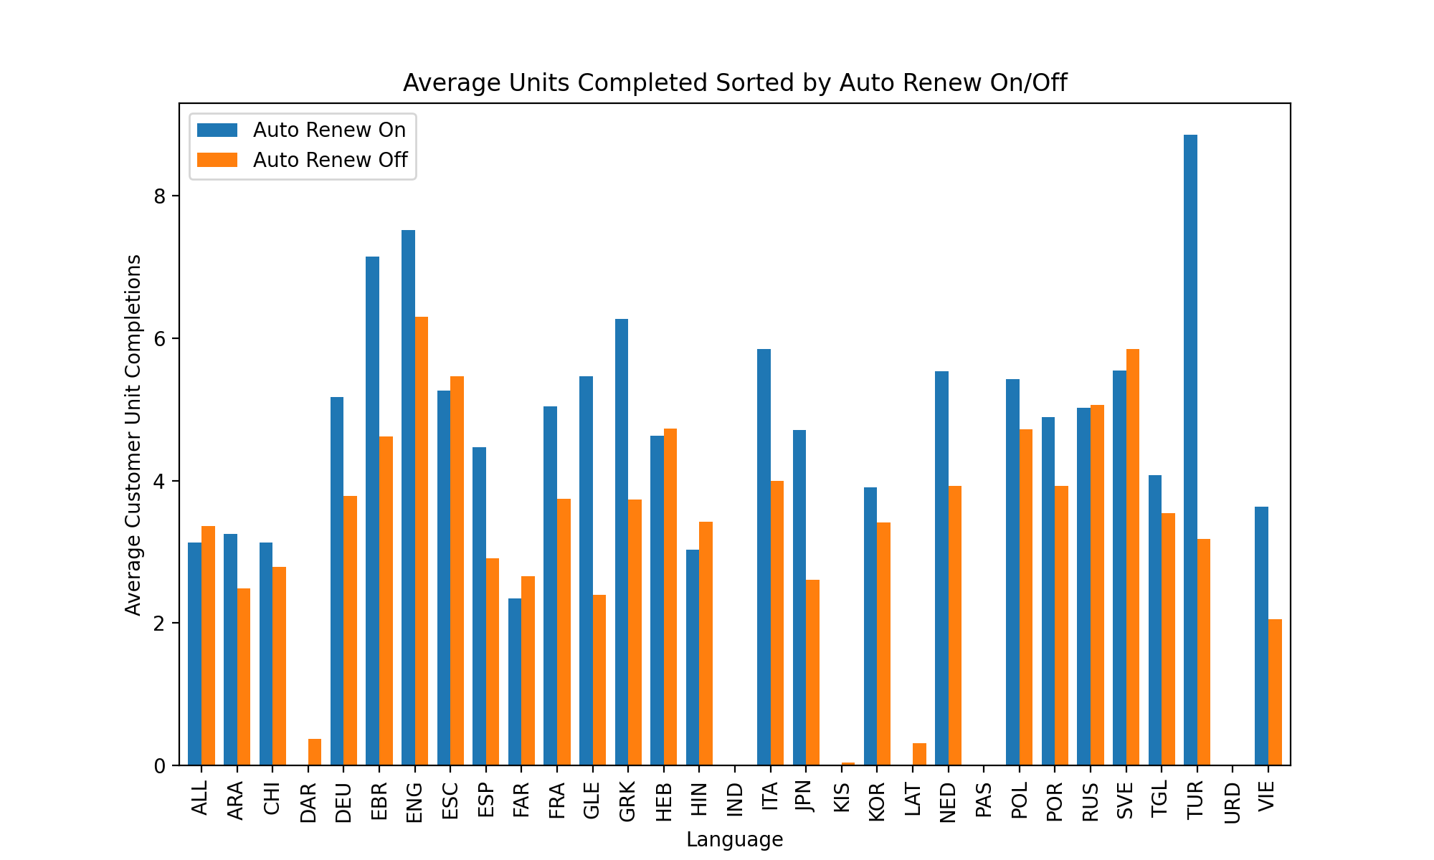
How do subscribers differ in behavior?
Q2
Behavioral Segment
Price Motivated:
Having auto renew off more often
Pay ~10% less on average
Have less overall interactions with the application
Have less completed units and modules in the application
Notes:
For the other group that’s Price Motivated, These customers are likely people who sign up when they see a discounted price point. They are opposite of content motivated people, they do not have a deadline they need to know the language by, and they are willing to wait for a better price and access the content later. These may include people who are learning a language as a loose goal (new year resolution etc), people who have thought about traveling somewhere but do not have a trip booked yet

Slide 13
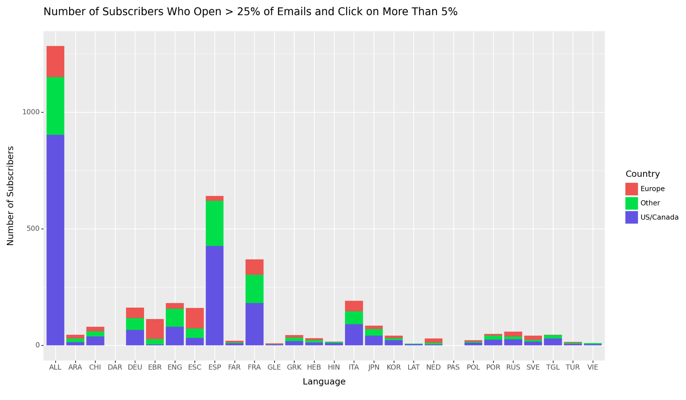
Which customers can we sell more to?
Q3
Customer Group
Customers who open 25% of our emails, and interact with 5% of them
No geographical affect
Clear geographical language preferences.
Limitation
These customers make up only 9.7% of our customer base
Upsell Possibility
Targeted promotions towards languages with higher i.e, US/Canada have a higher interaction rate with European languages.
Notes:
To find who we believe to be the customers most likely to be sold additional products, we felt that leaning heavily into customer’s email behavior would be vital information to assess. We isolated users who open 25% or more of the emails Rosetta Stone sends them and have a 5% or more interaction rate with those emails they open. We created this threshold based on benchmarks we found from MailChimp, a popular email marketing company: 21%, while the benchmark click rate is 2.9%. Sadly this group is only 9.7% of Rosetta’s customer base, and 20% of this group already have a lifetime subscription. We acknowledge that this is a very low percentage of customers. But we still believe that is the best metric to identify customers we can sell more to. Now, looking at the graphic, we can see possibilities of marketing packages we could sell based on demographics, for Example, a bundle or promotions for european languages for US/Canada subscribers because the interaction rate is typically much higher for those languages.

Slide 14
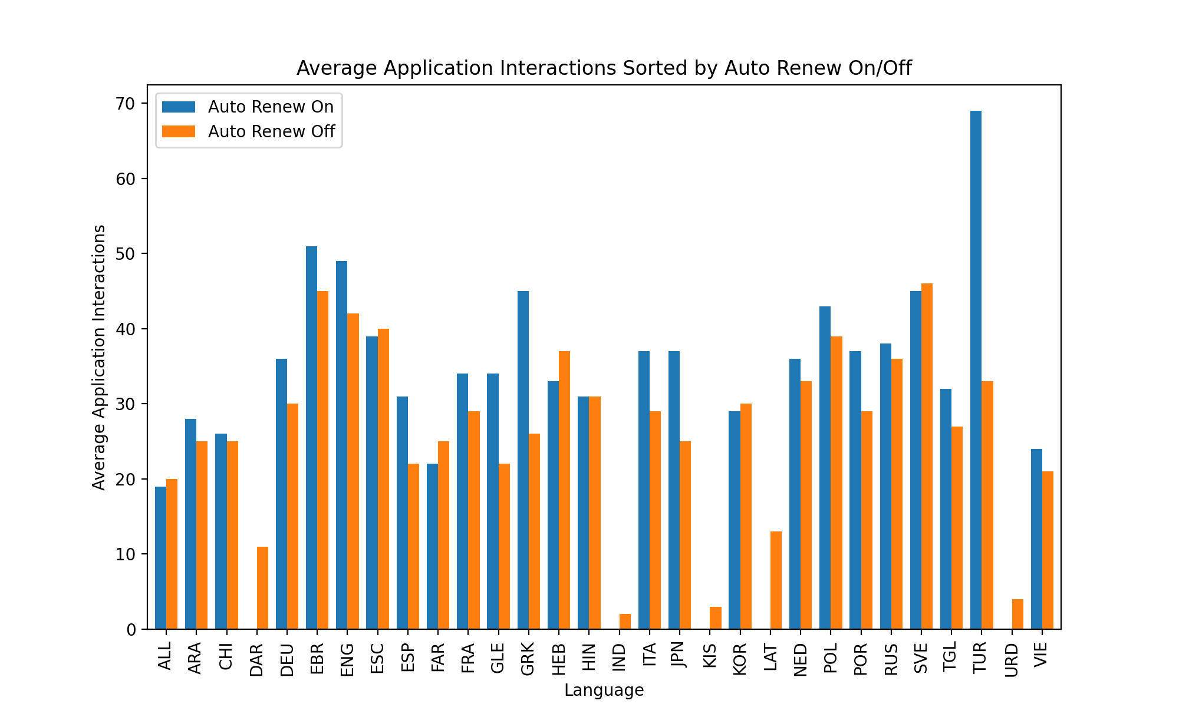
Profiling our customers not continuing
Q4
Customers with auto renew off equate to 60% of all limited customers.
Profile matches our segmentation group of Price Motivated customers:
Tend to subscribe for ~3 months less.
Pay on average 10% less.
Will usually have less application activity and completed units and modules.
Notes:
There are many similarities we found between customers without auto renew and our Price Motivated customers, they aren’t subscribed for long, they pay less, and are not as active with their learning. This makes up 60% of our limited subscribers. This is a large number of people who we need to target with the goal of turning them into auto renew customers. How might we do that?s are do not have auto renew on. These only include limited subscribers due to the fact that any lifetime subscriptions will have auto renew off by default.

Slide 15
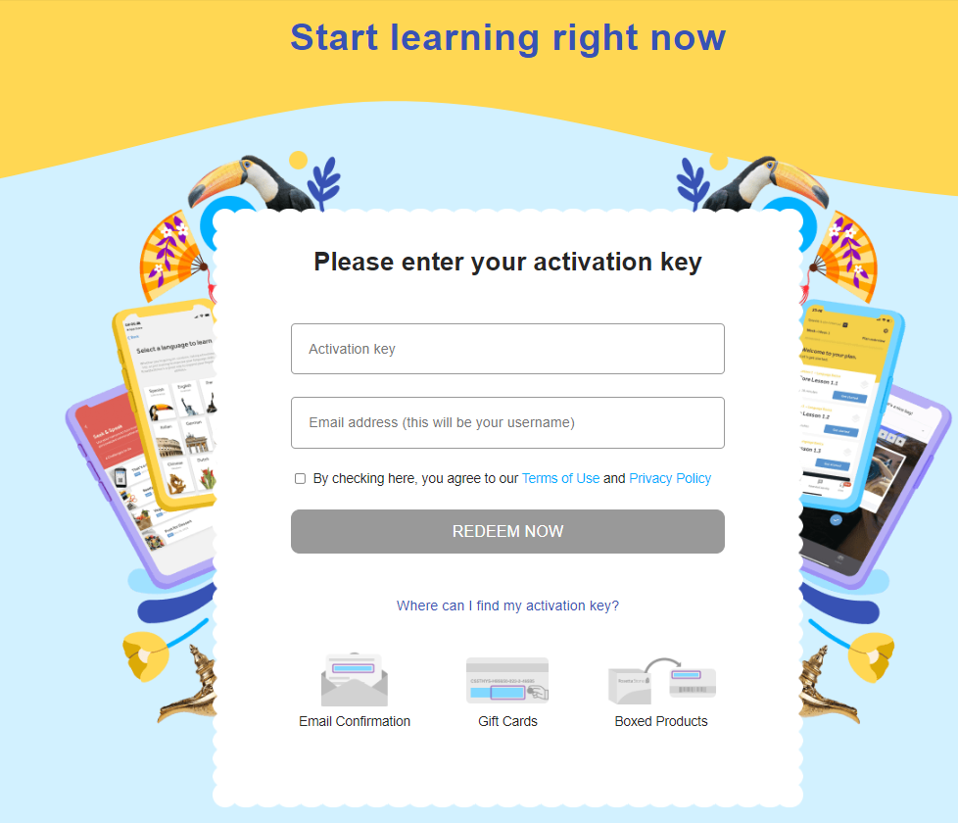
Barriers to Engagement
Q4
We identified Email Subscriptions as our largest barrier to engagement.
Only 47.5% of our customers are subscribed to emails.
These customers have an average click rate of 26% which is above MailChimp’s benchmarks for our industry.
Customers with auto renew off have lower engagement, and show to be subscribed less to emails (only 43%)
We recommend to focus on converting non-renewing subscribers to email subscribers to improve engagement metrics.
Notes:
Summing up the previous slides, we believe that converting customers to Auto Renew is vital for increasing engagement, and the best way to do that is through email interactions. That is why our biggest barrier is that only 47.5% of customers are subscribed to emails. And those that do have a higher click rate. The more customers we can get to subscribe to emails, means the more customers we will convert to auto renew, which means more active users, which means more profit. Email subscription is key.

Slide 16
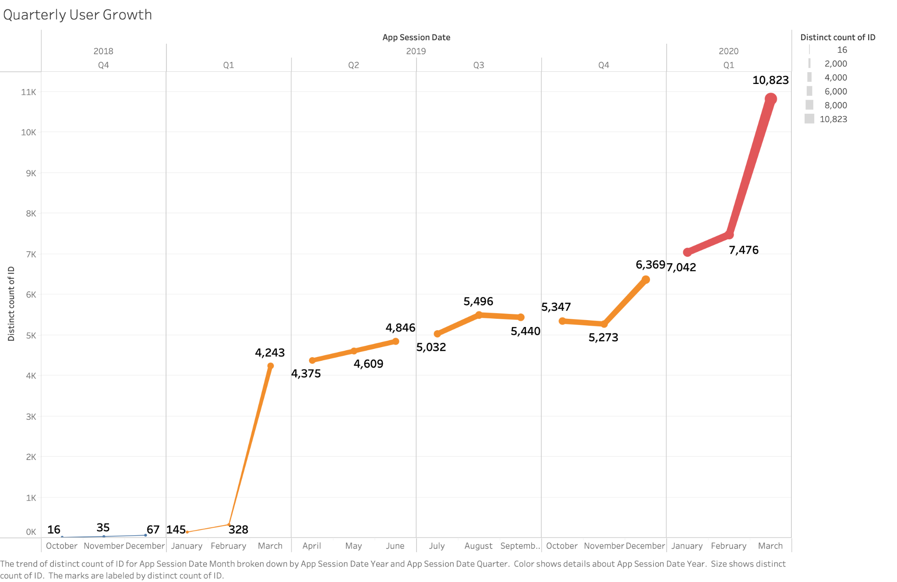
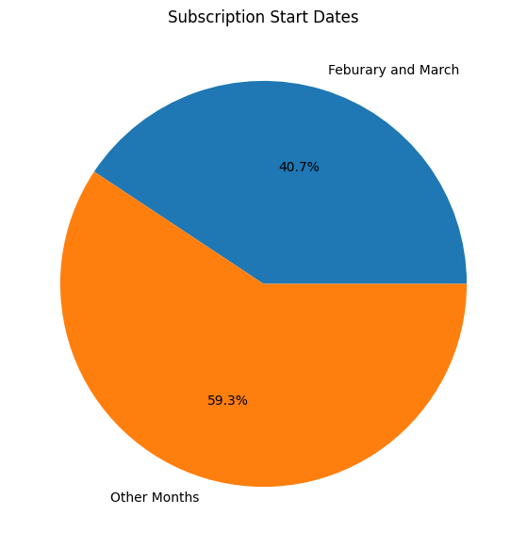
40.7% of our subscriptions begin within 2 months
Q5
Repeated surge in app activity during February and March. (App Activity data)
Correlated the phenomenon with subscription start dates. (Subscription Data)
40.7% of annual subscriptions begin in only February and March
Notes:
Lastly, during our data discovery phase of this project, we created a visual that plotted quarterly user growth based on the app activity data which is the graph on the left. We noticed a repeating trend in our data that during the months of February and March each year, distinct application sessions increase drastically. With such a significant increase and the repetitiveness of this trend, the group wanted to investigate this further. We first hypothesized that if we are seeing increased application activity, we may be able to correlate this with the subscriber data and identify the most popular months for subscription growth. After creating a starting months column in our subscriber data, we were able to identify the number of customers who began their subscriptions within February and March. Referring to the graph on the right, we quickly were able to identify and visualize that almost 41% of our customers begin their subscription in either February or March. The spike in 2020 could’ve been due to people preparing for vacations/trips/traveling before the pandemic occurred.

Slide 17
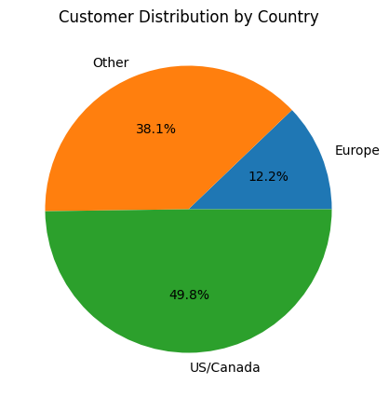
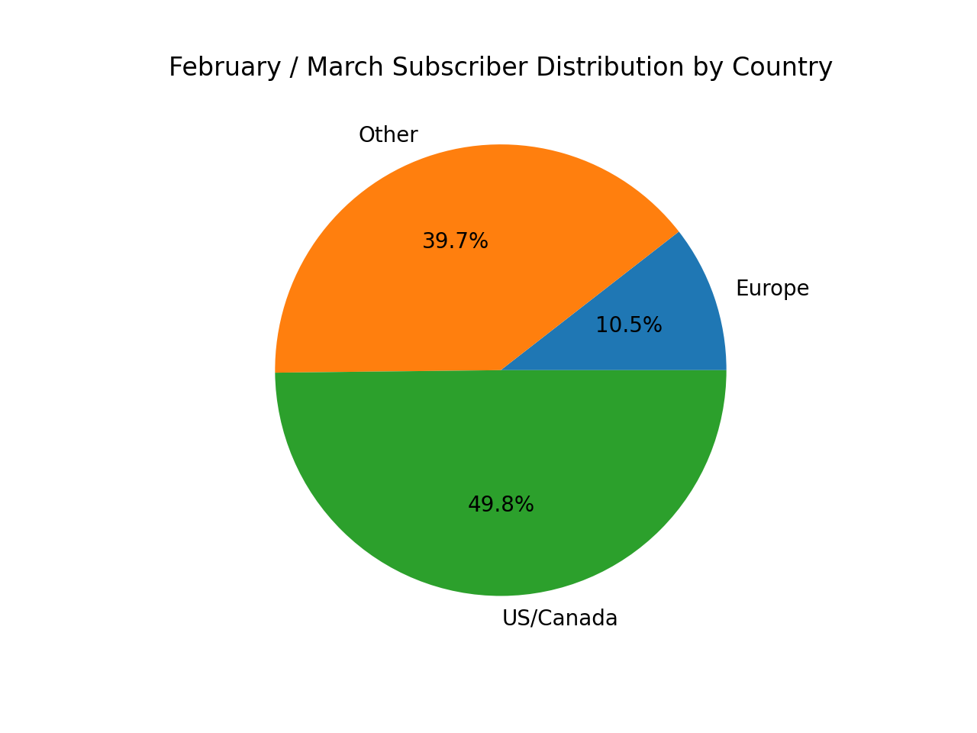
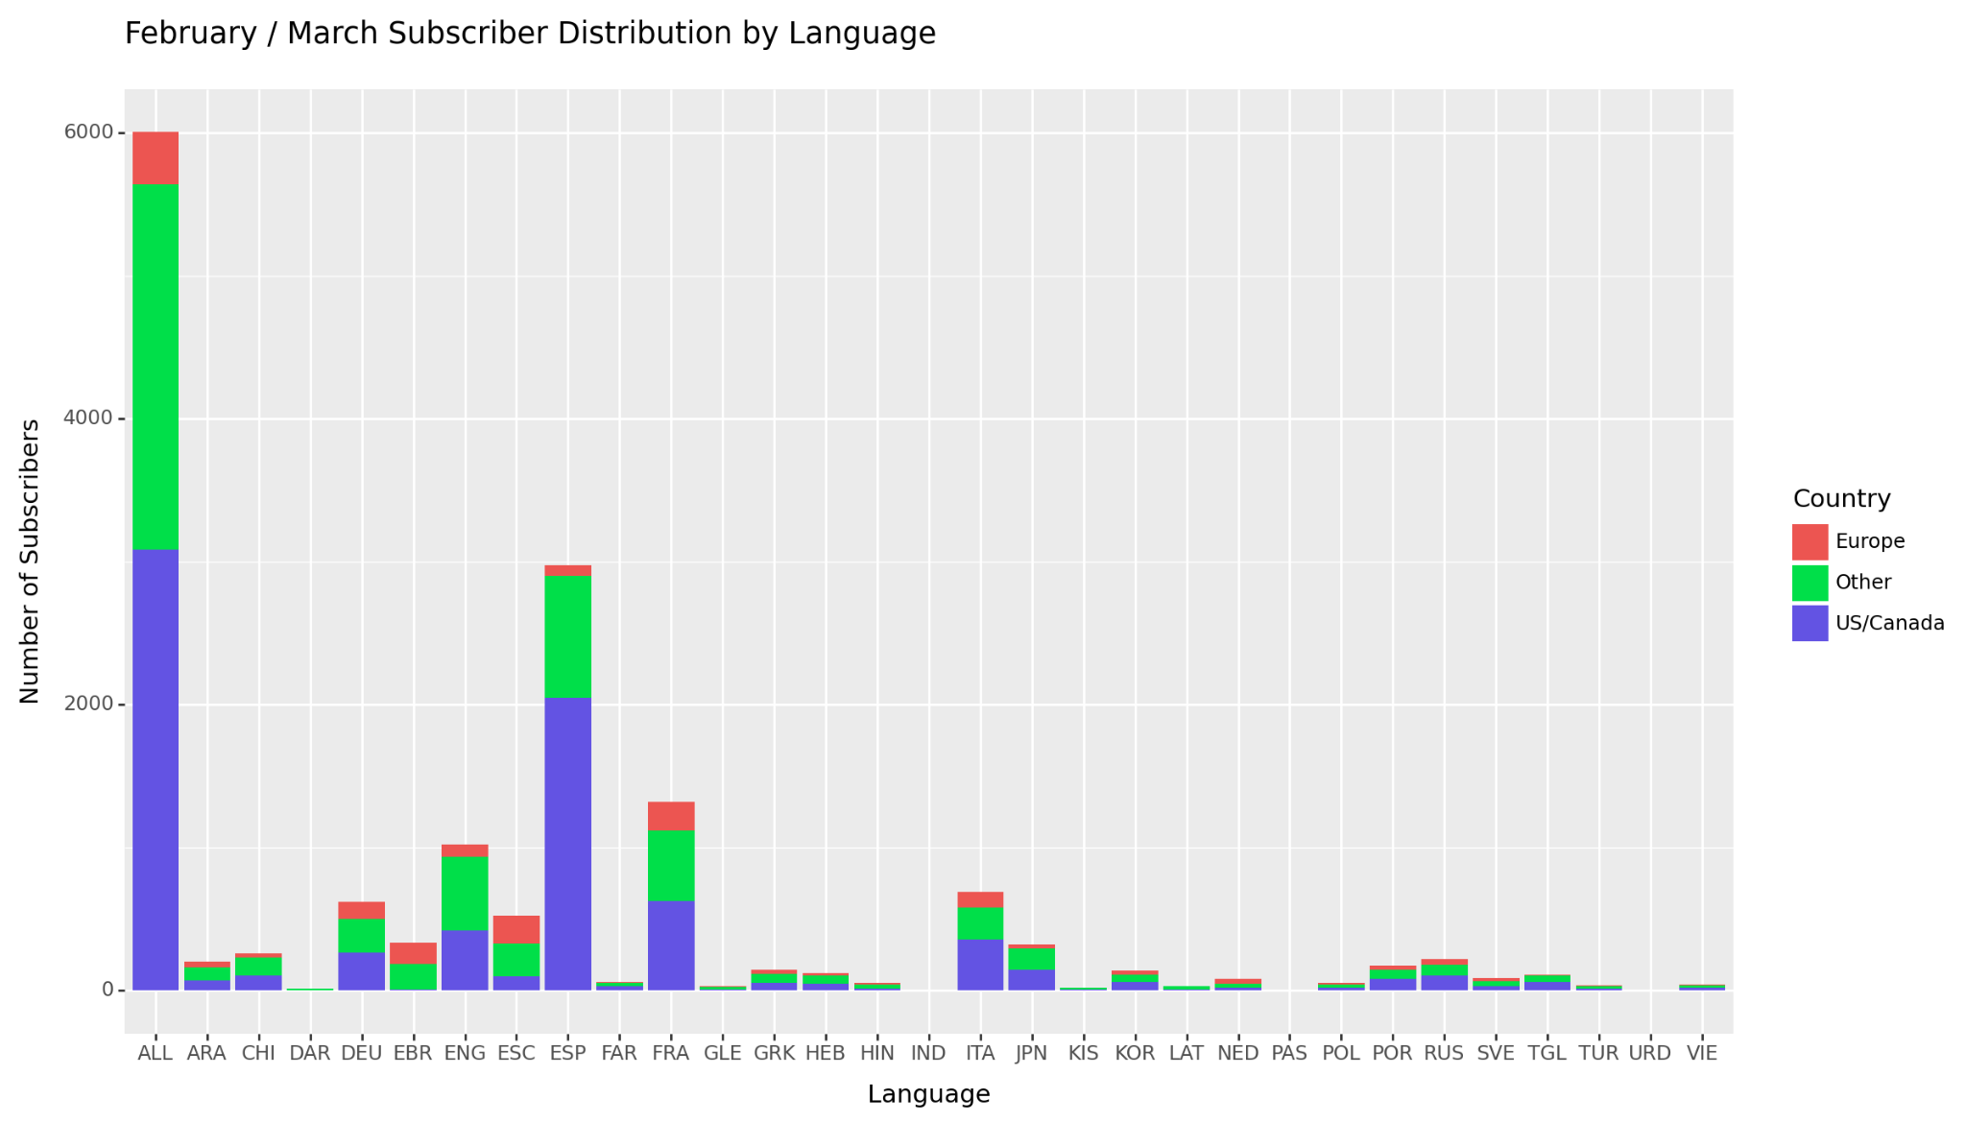
Further Analysis
Q5
Geographic location does not significantly impact subscription trends in these months
There is a concentration of country origin in specific languages during these months.
Notes:
Upon further analysis, the group identified two main points of these subscriptions that started within this time frame.
First off, based on the pie charts on the left, the location distribution of all our customers and our customers beginning a subscription in February or March are almost identical. This leads us to believe that geographical location does not significantly impact the number of subscribers in this timeframe.
Staying on the idea of observing the data by country, the group then created the graph on the right. This graph shows us that, of the customers beginning their subscription in this timeframe, there are more popular languages by the subscription’s country of origin. To identify trends, the group elected to only look at languages that are not ALL.
Our findings concluded that of our February and March Subscriptions, there is a higher concentration of U.S and Canada in languages like ESP, FRA, and ITA which we lightly identified as European Languages. Europe has a higher concentration in languages like EBR, ESC, and FRA. While the other countries category displays higher concentrations in ENG, ESP, FRA.
We believe that these trends could be attributed to summer travel plans and customers attempting to learn languages of areas they may be traveling to. We came to this idea based on the fact that our most popular months coincide right before the summer months, which is the most popular time of year for traveling.

Slide 18



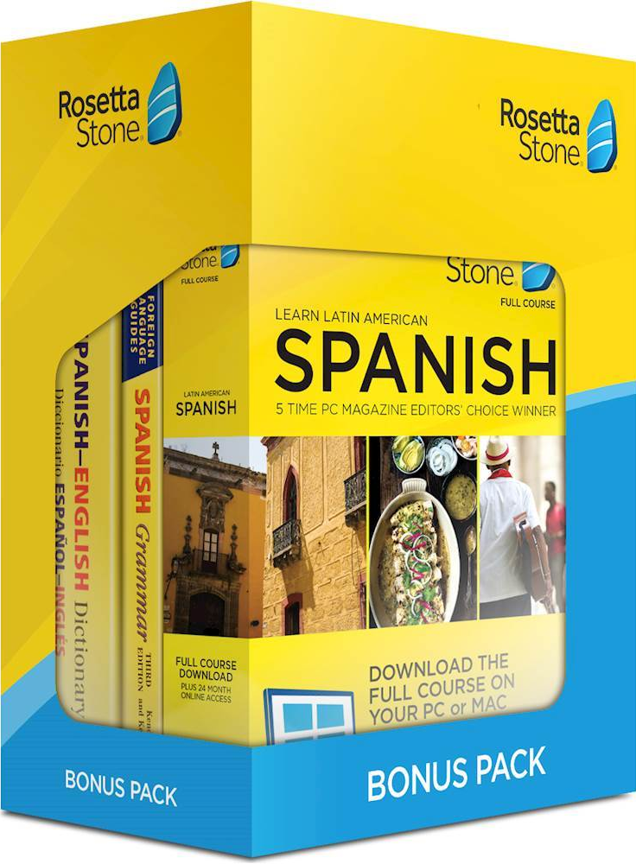
Relevant Business Opportunities
Opportunities
Increase marketing efforts during peak months to leverage high conversion rates
Run more global promotions to incentivize customers
Offer bundles tailored to popular destinations relevant to these months (e.g., France and Spain)
Notes:
Utilizing these insights and analysis, we believe we have found multiple business opportunities.
In hopes to increase marketing conversion rates we could:
Increase marketing geared towards summer travel during these popular months.
Secondly, based on our country of origin concentration in certain languages, we could target specific language subscriptions to different countries during this time

Slide 19
Conclusion/ Executive Summary
Notes:
Our Conclusion is…

Slide 20
Executive Summary Recommendations
Target Scope:
Balance efforts between converting existing customers to ALL-Lifetime subscriptions and acquiring new customers to replace converted customers.
Utilize tailored marketing strategies based on customer behavior and geographical data to enhance conversion and retention.
Leverage seasonal trends for strategic promotional campaigns.
Notes:
In summation, we want to balance between converting existing customers into lifetime subscriptions, and acquiring new customers for a reliable cash flow. We want to take advantage of our geographical and behavioral data to enhance marketing strategies. One idea would be to include coupons in emails to encourage email engagement.

